Slide 1
Microservices and Web Application Architecture
Cybersecurity
Lesson 13.2

Slide 2

Learning Objectives
By the end of today’s class, you will be able to:
1
Understand how microservices and architecture work to deliver more robust, reliable, and repeatable infrastructure as code.
2
Define the different services within a LEMP stack.
3
Describe how relational databases store and retrieve data.
4
Create SQL queries to view, enter, and delete data.
5
Use Github Copilot to create a front end.

Slide 4

Application Structure

Slide 5
Application Structure
Today, we'll take a deeper look at the infrastructure behind web applications.
01
Components that make up web architecture and their software "stacks"
02
How web application components can be deployed using containers
03
How databases work to understand how web apps store and transmit data
04
How AI can be used to create websites easily using GitHub Copilot

Slide 6


Demonstration Scenario
Andrew, a developer, uses a browser to manage a public-facing application (the Employee Directory App), where he retrieves and updates different kinds of employee lists of his company. The app is set up so that Andrew can add, remove, and view employees.
This app needs the following components to function:
Front-end server
Back-end server
Database
Notes:
shutterstock_1888488028

Slide 7
Application Structure
Components of a Typical Web App
Front-end server | Responsible for displaying webpages and styling them in a readable format. This server also receives and responds to HTTP requests.
Back-end server | Executes business logic and writing or reading corresponding data to and from a database. The back-end server knows how to interact with the database depending on the specific request received.
Database | Stores information on employees, such as their employee IDs and names. Critical and sensitive information is found in databases.

Slide 8
Now that we know the main components of a web application, we want to know what happens behind the scenes when a user interacts with a web application, or more specifically, makes an HTTP request to the server.
https://www

Slide 9
Information flows Between Application Components
Andrew loads the application in his browser and clicks a button to display all HR employees.
Employee directory
application
Browser displays new page with a formatted list of HR employees.
Front-end server
Front end forwards request to back end.
Front end prepares a new webpage with a list of all HR employees.
Back-end server
A back-end script queries the database for HR employees.
Back-end script forwards list of HR employees to front end.
Database
Database sends IDs with “HR” to back end.
Database searches for all IDs with “HR.”

Slide 10

Modern Architecture

Slide 11
Microservices are several services that run on a server in order to run a web application.

Slide 12

Modern Architecture
Web applications today are composed of many microservices
One of the first steps in creating microservices is separating components in individual machines to run a “service.”
A service, such as the front-end server, is really just an operating system, running a minimum amount of software to serve one main purpose.

Slide 13


Web Application Architecture
Each individual machine requires:
Linux operating system
An operating system to run on in order to run the service’s software and store its configurations.
The software that runs a specific set of instructions for that individual component of the web application.
Front-end server
Back-end
application server
Database
For example:
A database service runs Linux as
its operating system and has a MySQL database installed on it.
Notes:
Image sources: shutterstock_329468402, shutterstock_417078436, shutterstock_704749705

Slide 14

Introducing Stacks
What open-source and commercial software
do we need to set up in order to create our web application components?
Base operating system
Any combination of a base operating system, front-end software, back-end software,
and database is called a web stack.
Front-end software
Back-end software
Database
Notes:
shutterstock_1284781774

Slide 15





Introducing Stacks
Base operating system
Notes:
shutterstock_1284781774

Slide 16




Introducing Stacks
Front-end software
Notes:
shutterstock_1284781774

Slide 17



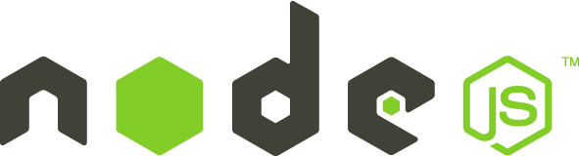
Introducing Stacks
Back-end software
‹#›
Notes:
shutterstock_1284781774

Slide 18

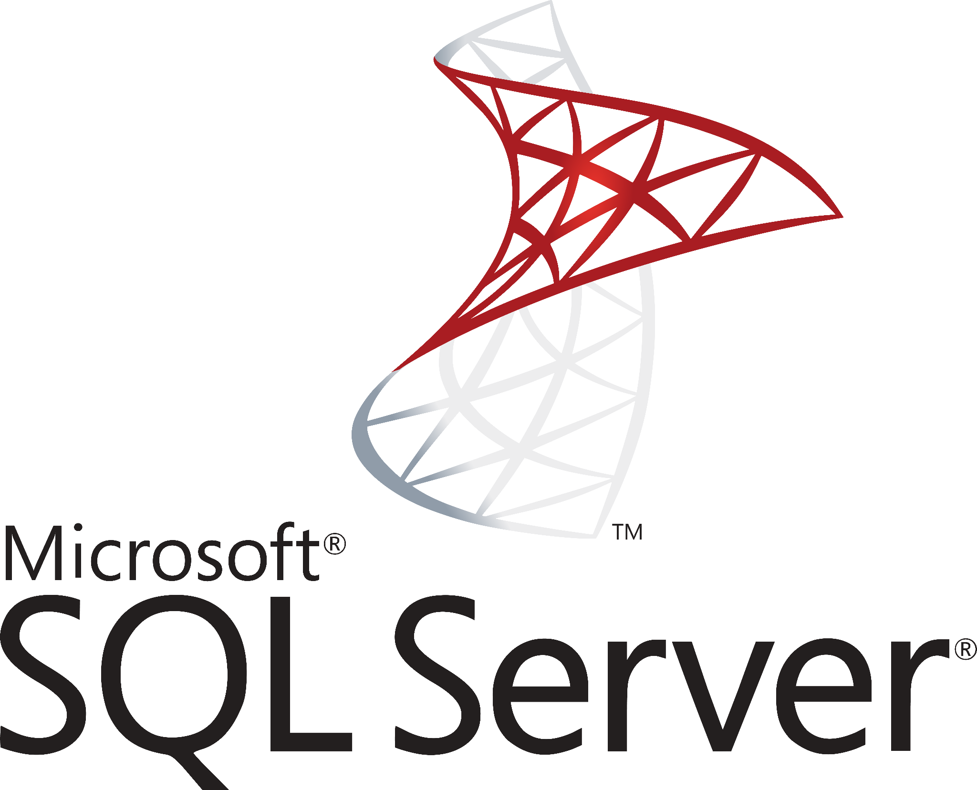


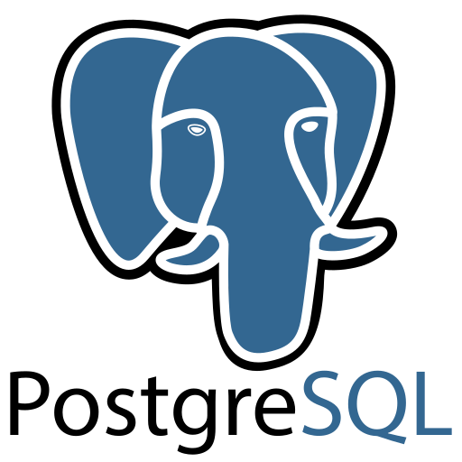

Introducing Stacks
Database
‹#›
Notes:
shutterstock_1284781774

Slide 19
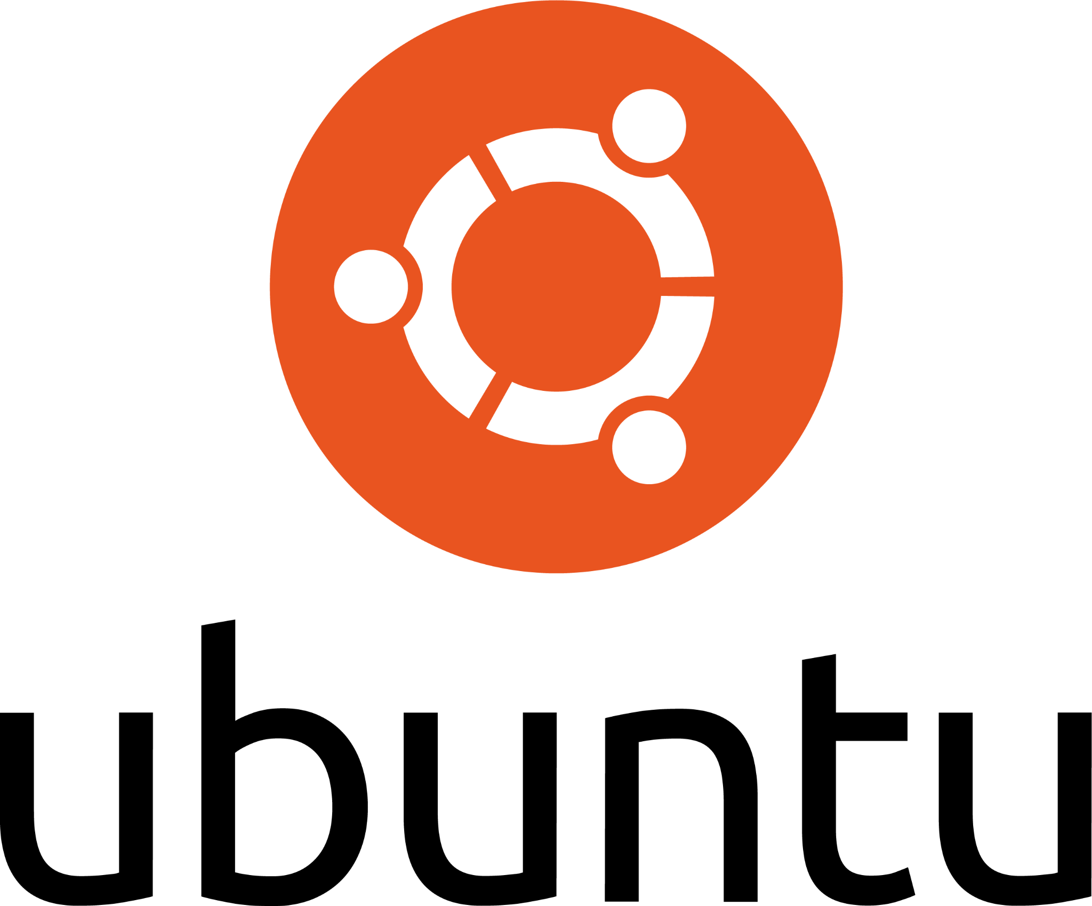
LAMP Stack
A popular example of a stack is the LAMP stack.
Linux as the base operating system
Apache to handle the front-end HTTP requests & responses
MySQL for storing data
PHP for back-end transformation of front-end requests and responses to database queries

Slide 20
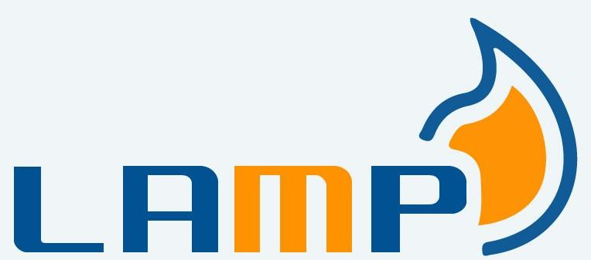





LAMP Stack
The LAMP stack is considered the tried and true web stack, with a long history
of use in architecting web applications.
The following sites either still use or originally used the LAMP stack:

Slide 21
More Stacks
These days, there are many more web stacks, which use different variations of software.
Linux operating system
Front-end server
But what stacks should we use.
for our own web application?
Let’s take a look at some options.
Back-end
application server
Database
Notes:
Shutterstock_1647368755_multitask WITH character frrom CANVAS scripts incorporated for diversity. See Trilogy VSG https://drive.google.com/drive/u/0/search?q=Trilogy%20VSG

Slide 22

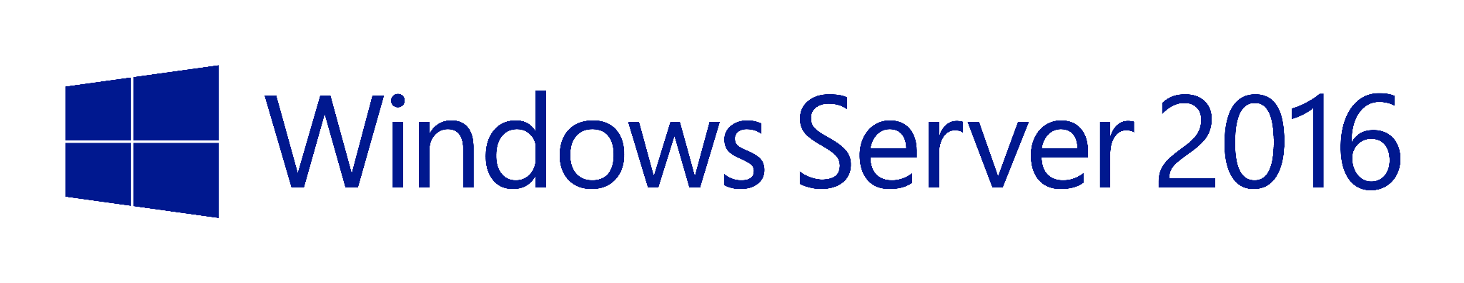
Common Web Architecture: Operating Systems
Let’s start by comparing the different operating systems available for our services.
The Alpine Linux is a super lightweight
Linux distribution that has the minimum requirements to run containers.
Other container-friendly operating systems include most other Linux distributions, such as Ubuntu, and more recent versions of Windows Server. The following base operating systems are used for web applications:
Common Linux distros such as:
Windows Server 2016 and higher

Slide 23




Common Web Architecture: Front-end Server
Our front-end server handles the HTTP requests and responses. It is usually some form of HTTP server running on a lightweight containerized operating system. The front-end server is the part of a web application that renders the visual components of a web application.
Primary front-end web design languages:
Specific examples of front-end servers:

Slide 24
Common Web Architecture: Database Server
Data for the application is housed in the database server. Remember that there could be multiple databases, some for storing sessions and cookies and some for storing business logic like a company’s employee directory.
Specific examples of databases:

Slide 25
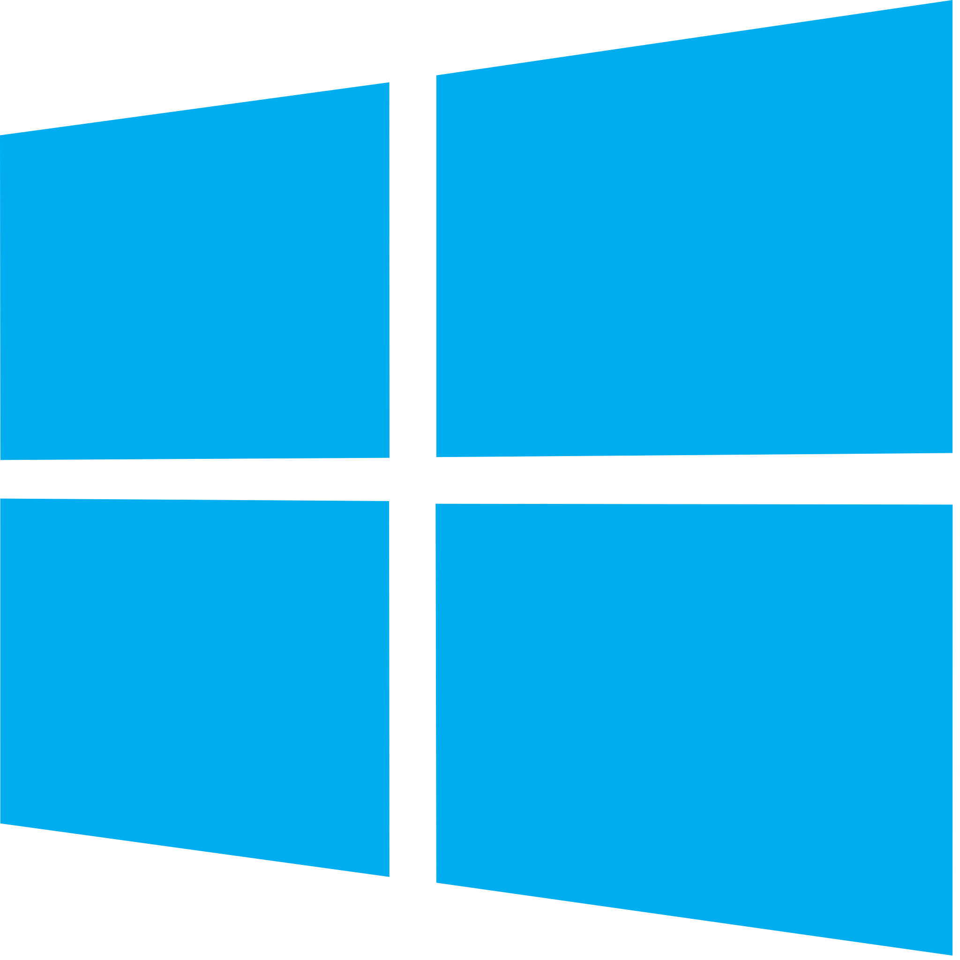
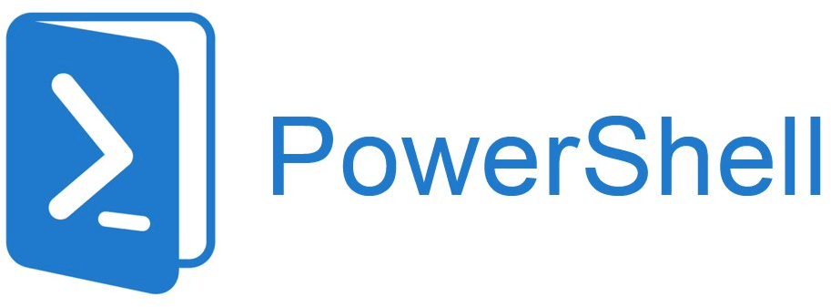
Honorable Mention: The WIMP Stack
There is also a Microsoft-based variation called the WIMP stack that uses the following:
Windows operating system
Microsoft’s IIS web server in place of Apache/Nginx
Like the LAMP stack, we won’t use WIMP in class, but it is good to know that Microsoft-
based web stacks are available.
Database such as Microsoft SQL Server
Back-end language such as PowerShell
‹#›

Slide 26


LEMP Stack
The web software stack that we’ll use for today’s demos and activities consists of:
L
Linux
The standard underlying operating system used for web applications. However, we will use it with containers.
E
Nginx
We’ll use nginx for our front-end HTTP server, instead of Apache, mainly for its speed. While Apache is considered to have more features and is more compatible with back-end languages such as Java, nginx is well known for its performance.
M
MariaDB
Unofficially the “other” MySQL, it is a standard relational database that will handle our data storage.
P
PHP
Our pages will be generated with data pulled by PHP scripts. We will not need to manage or work with any PHP directly today, but know that it is acting as our back-end language.

Slide 27
We just covered all the software that we want to use for our web application, but what about the hardware?

Slide 28

Microservices Infrastructure with Containers
Microservices require lightweight environments, because:
Our microservices need to be rapidly deployable.
We need to be able to scale our microservices to meet growing demand.
Developers and maintainers need to be able to replicate their own copies of these microservices locally.
Having full-sized virtual machines for each service would require more resources and be more costly.
Can anyone think of a technology we've covered in class that can create isolated virtual environments?

Slide 29
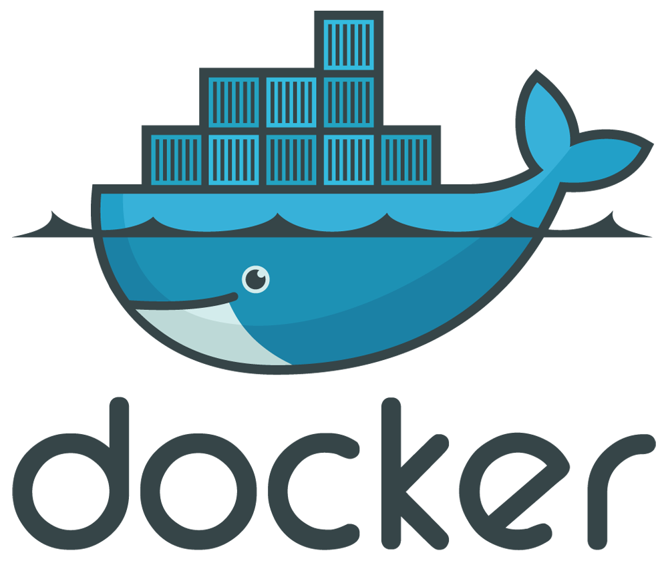
Microservice Infrastructure with Containers
Containers run as isolated, virtual operating systems that dynamically allocate resources depending on needs.
This is unlike regular virtual machines, where all hardware is virtualized.
Docker is the most popular container platform. For the rest of this class, we will refer to Docker’s implementations of containers.

Slide 30
Containerization is the process of packaging all the requirements to set up a microservice as a container.

Slide 31
How a Container Becomes a Microservice
Containerizing a microservice requires the following steps:
01
Declares a base operating system for the microservice to run on.
02
Stages the microservice's source code to the container.
03
Sets a command that launches the microservice and all other needed software when the container is deployed.

Slide 32
Dockerfile
Containerization can be declared in a text file called a Dockerfile.
###############################
# Employee Directory Application
###############################
# Required Base OS
FROM ubuntu:14.04
...[truncated]
Dockerfiles contain all the configuration needed for a container in one file.
This is similar to an Ansible configuration file, which contains everything needed to configure a host with the command: ansible-playbook your-playbook.yml.

Slide 33
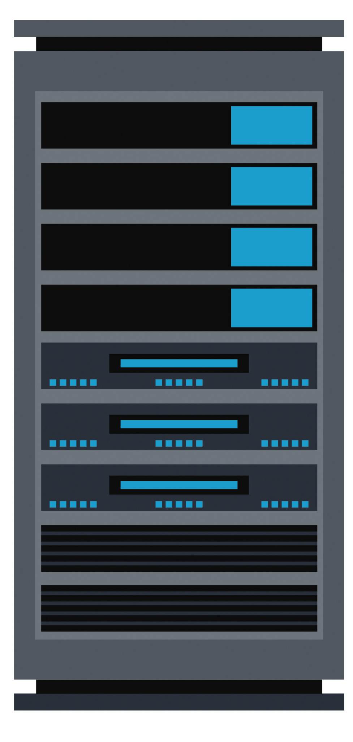
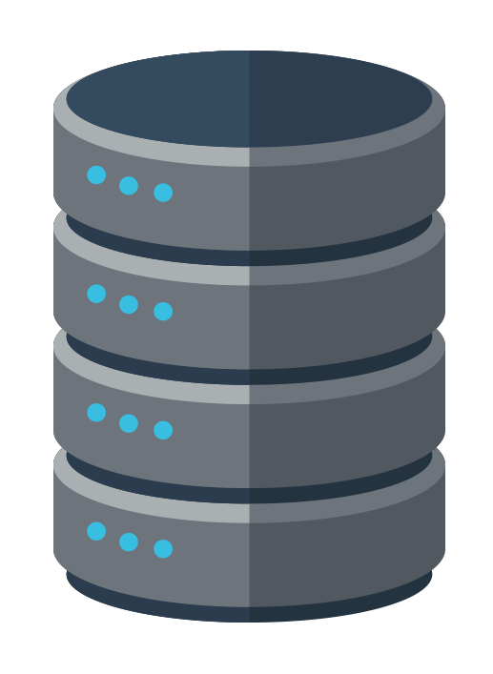

Product Directory app
Dockerfile
###############################
# Product Directory Application
###############################
# Required Base OS
FROM ubuntu:14.04
A unique Dockerfile
is created for each microservice.
Dockerfile
###############################
# Product API
###############################
# Required Base OS
FROM fedora:31
Product API
Dockerfile
###############################
# AMAZON Database
###############################
# Required Base OS
FROM centos:8
Database
‹#›
Notes:
Image sources: shutterstock_329468402, shutterstock_417078436, shutterstock_704749705

Slide 34
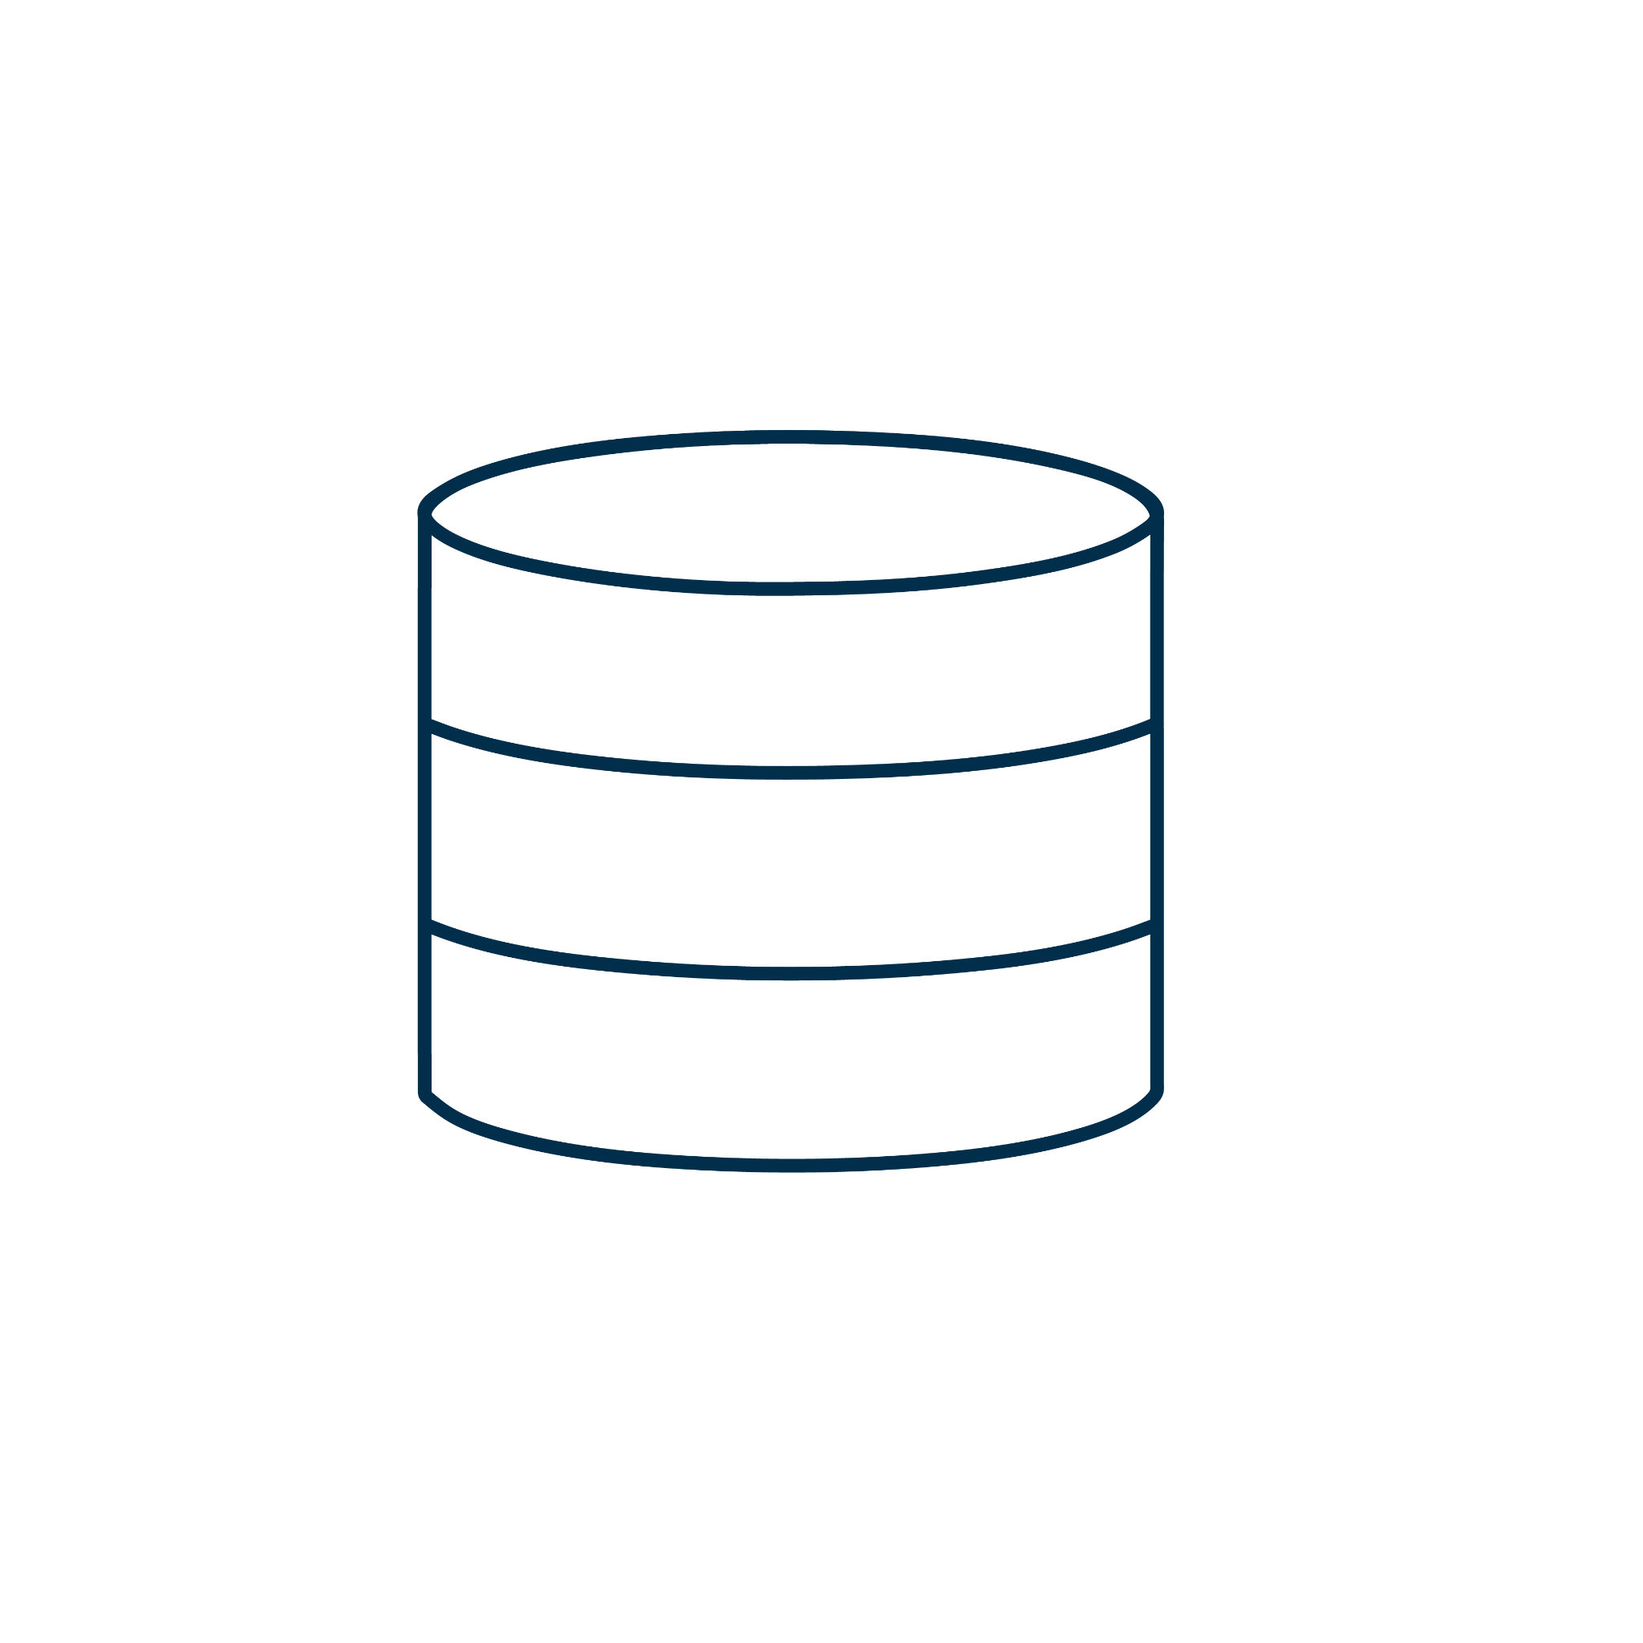
Intro to Databases

Slide 36

Recap
Let’s recap everything we’ve learned so far today:
01
How to describe web application architecture
02
Defining specific web application architectures
03
How to deploy and test that a container set is running and functional

Slide 37
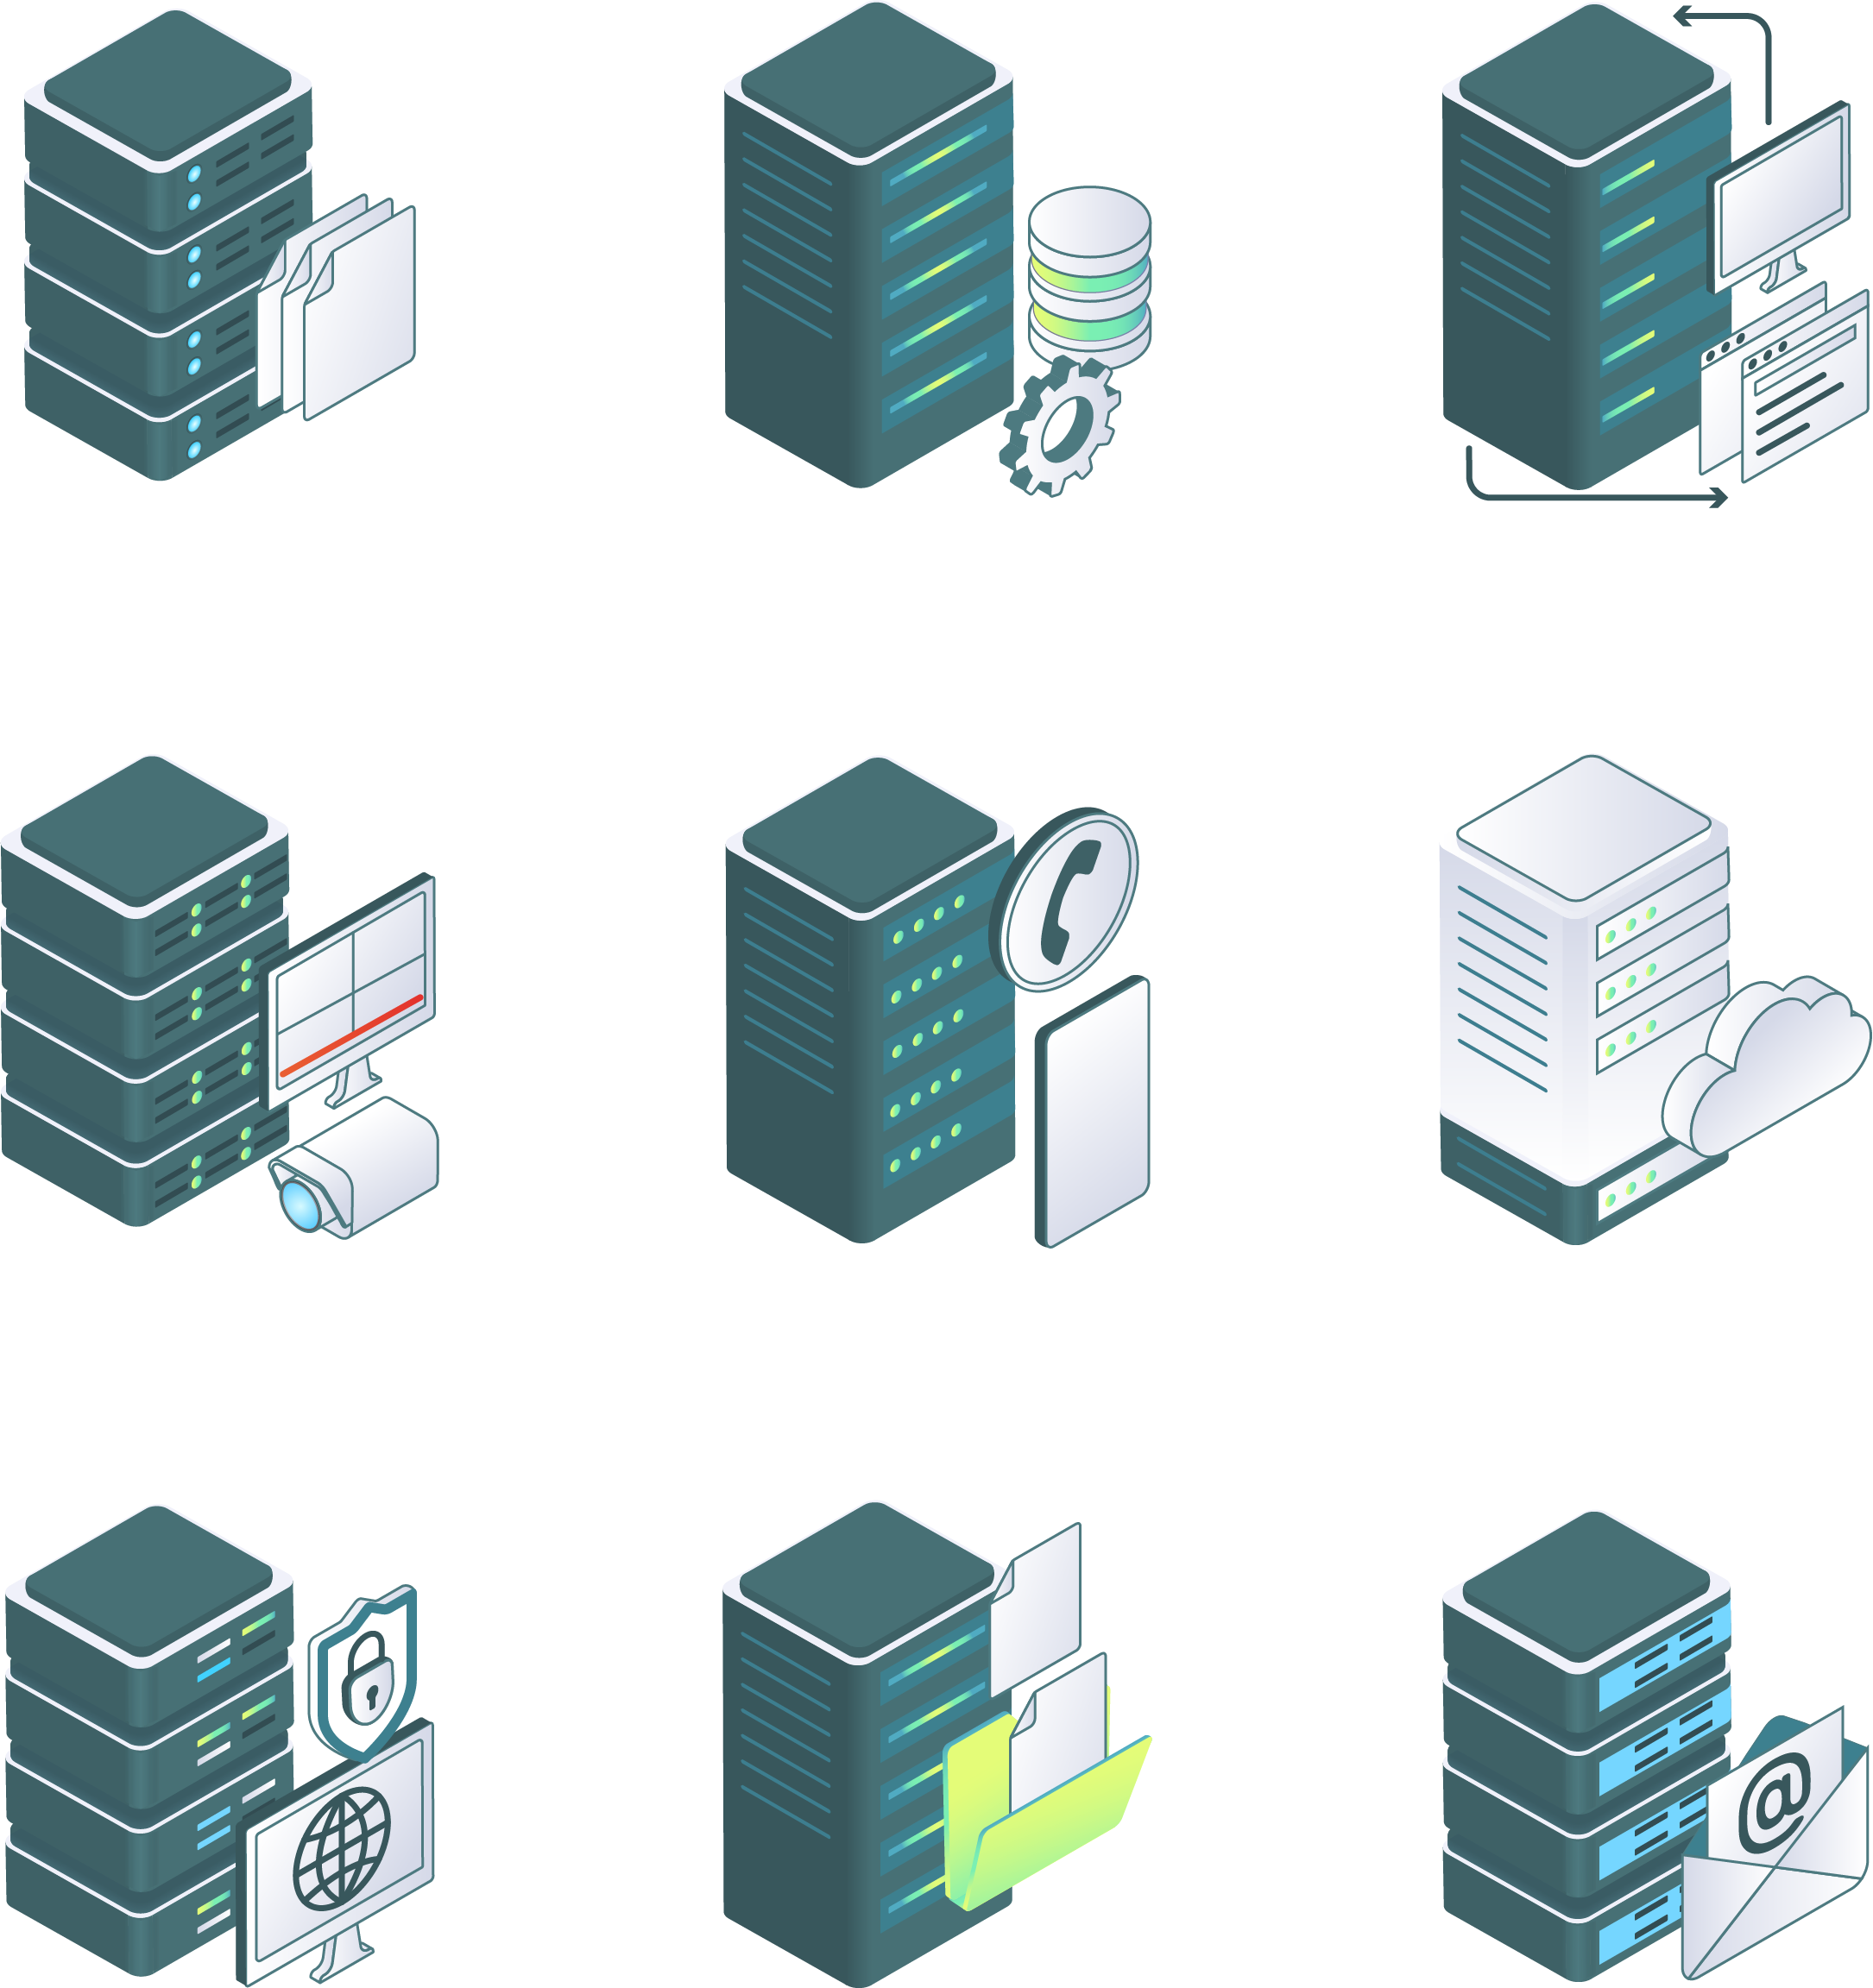
The Importance of Databases
Databases contain the persistent data that flows through the web application.
The data in the database can include, but isn’t limited to:
The usernames, telephone numbers, and email addresses of customers
The session and cookie IDs of site visitors
Personally identifiable information, such as the full names, dates of birth, credit card numbers, and social security numbers of customers
File
server
Database server
Proxy server
Video server
VoIP server
Virtual server
Virtual private network server
File Transfer Protocol server
Mail
server
Notes:
shutterstock_1713890323

Slide 38


The Importance of Databases
It is absolutely crucial that security professionals have a strong understanding of how databases work in
web applications.
We’ll examine the threats and vulnerabilities of databases more closely later in the course.
Notes:
shutterstock_1095422036

Slide 39
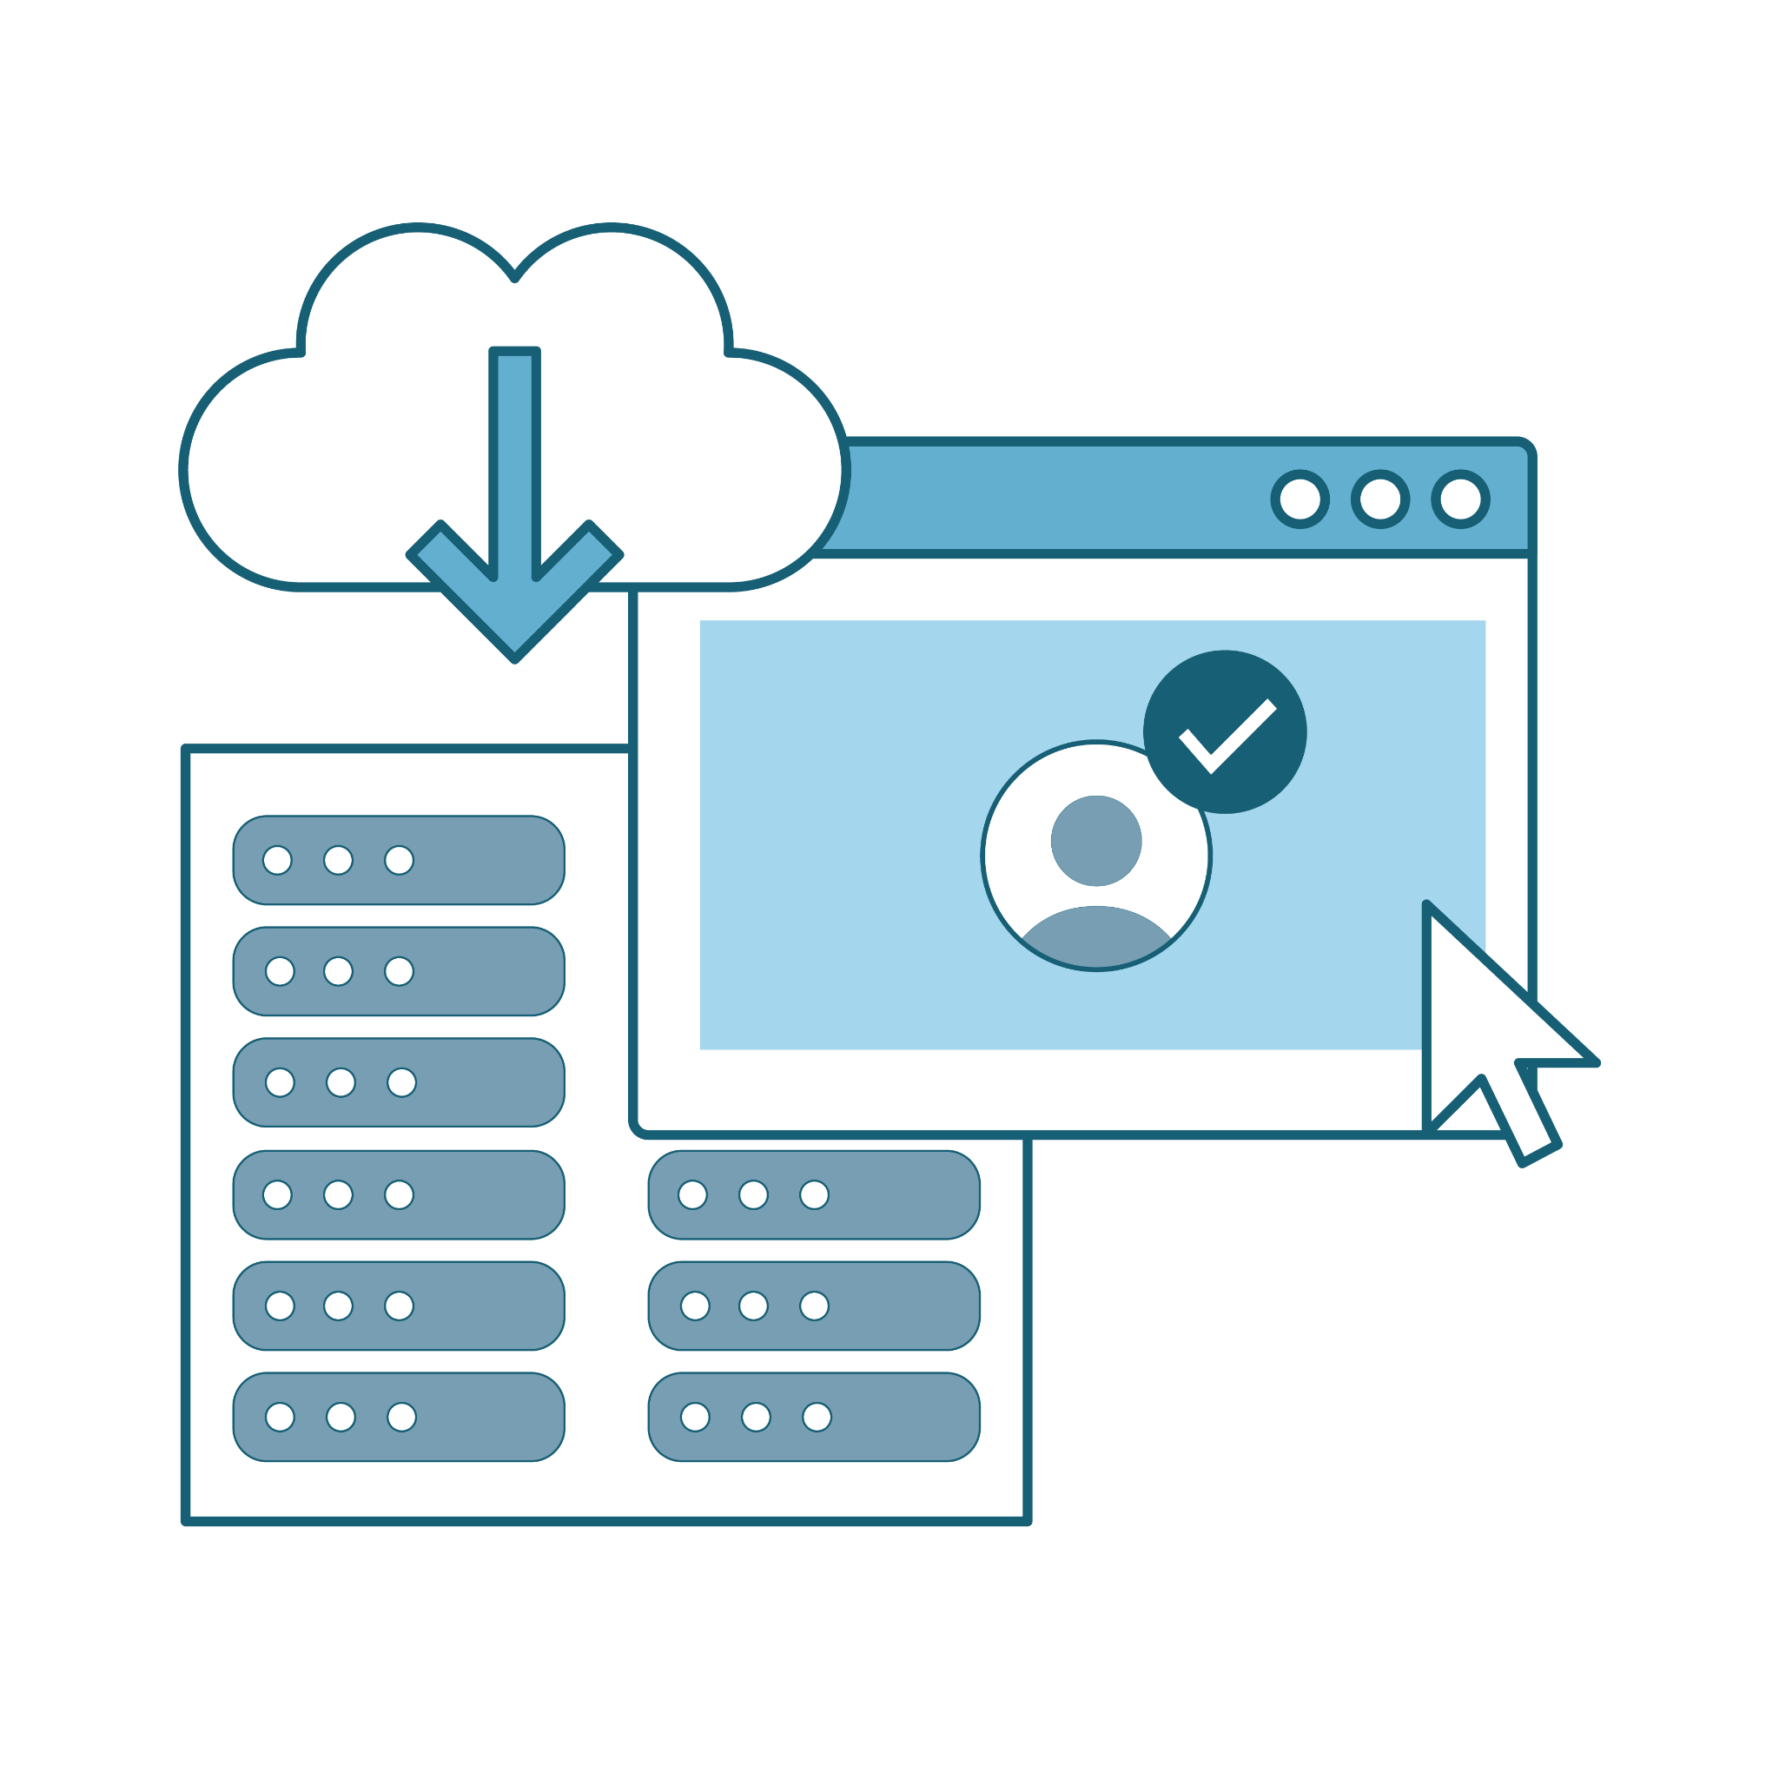
Databases Overview
Databases are used to store large amounts of data.
Databases are typically kept separate from the other components of a web application.

Slide 40

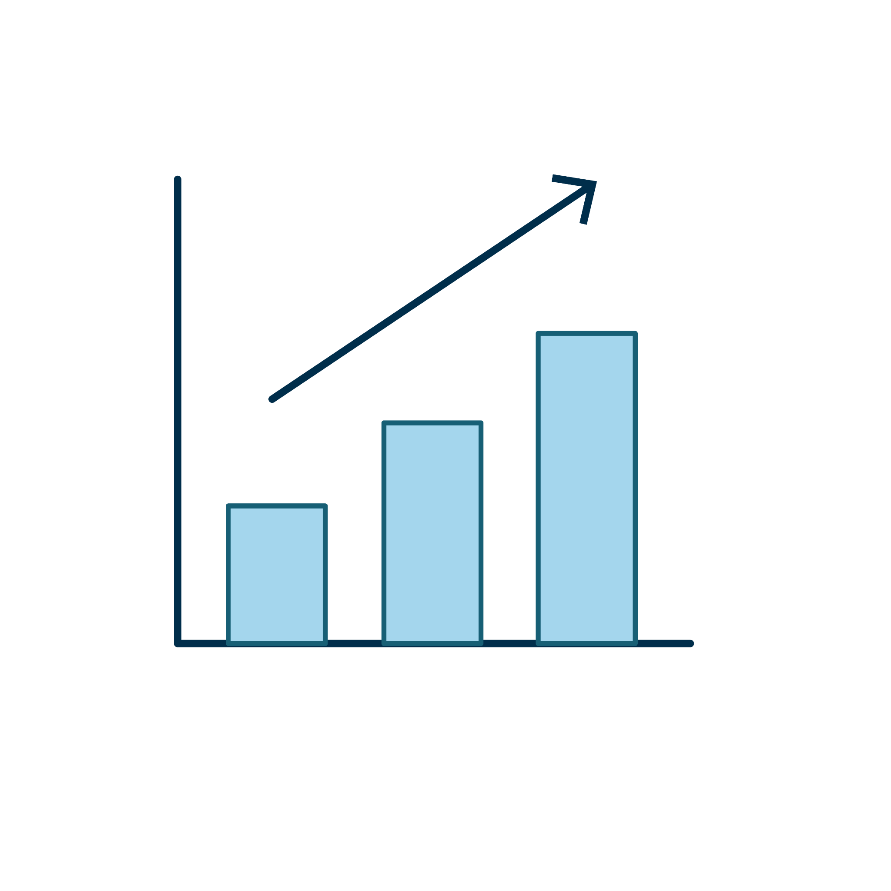
Databases are typically kept separate
Why we separate databases from other web apps:
Security
Compromise of one machine does not imply compromise of the other.
Scale
Many servers may use
the same database.

Slide 41

As we saw in our last demo
and activity, this was the case
in our docker-compose.yml file.
compose
We had multiple defined services, and the database was its own container demo-db in the demo and db in the activity.

Slide 42
SQL Databases
While the two most important types of databases are SQL and NoSQL, we will focus only on SQL today.
SQL databases organize data like a spreadsheet.
Each column is a piece of data in the row.
Each row
is an item
in the database.
ID | First Name | Last Name | Department
1 | Jane | Doe | Security
2 | Bob | Competent | Marketing
3 | Jon | Rolls | Modeling
A whole “spreadsheet”
of rows and columns is called a table.
A collection of tables is called a database.
Query
Language

Slide 43
Interacting with Data
Once you’ve created a table, there are four main ways to interact with the data
it contains. Together, these are as known as CRUD operations.
Create | Add new entries to a database. | When a user makes a new account in a web app, they are creating a new database entry with their user info.
Read | View entries in a database. | When a web application verifies your login credentials, it is reading the saved credentials it has in the database.
Update | Modify existing data in a database. | Whenever you need to reset your password in a web application, the password entry (more specifically, the hashed password) is updated with the new password.
Delete | Destroy data in the database. | If you have the option to delete your account from a web application (for example, on a GDPR web app), your account info will be deleted from the database.

Slide 44

CRUD
CRUD operations are also known as queries.
We’ll use the term “query” to describe any input that will interact with data.
We’ll come back to the SQL syntax of these operations to set the stage for SQL injections later in the course.
Notes:
shutterstock_1335132566

Slide 45
SQL injections are a type of web application attack intended to manipulate queries so that an attacker can use a database in ways the developers did not originally intend.

Slide 46
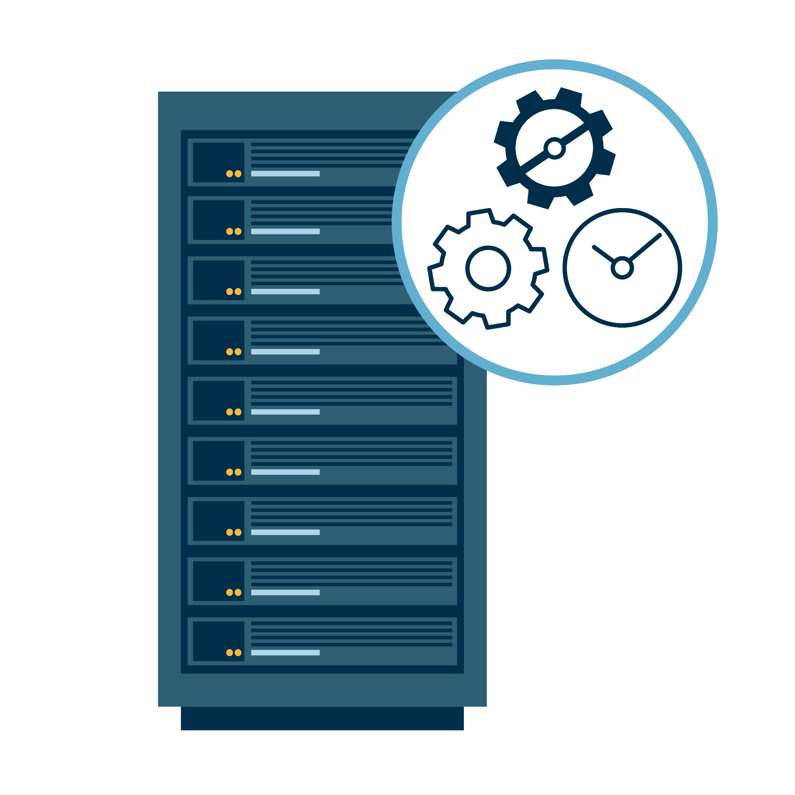
Demonstration Scenario
Let's see how we can create and enter queries into a web application's database to carry out basic database administration tasks.
Deploy a web application.
Navigate to the web application's page to see what data can be viewed by a web client.
Start a bash session in the database's container and log into the database.
Use a SQL query to retrieve the contents of the database's primary table.
Modify that SQL query to find specific data.
Add new data to the database.
Delete data from the database.
Notes:
shutterstock_1888488028

Slide 47
Database

Slide 48
Database Management
In this activity, students will play the role of a junior web engineer for the GoodCorp company and will manage its web application.
GoodCorp uses Docker Compose and a set of containers to deploy and maintain its employee database website and application.
They are tasked with locally deploying GoodCorp's employee directory website with Docker Compose. They also need to manage the data inside the employee directory database.
25 Minutes

Slide 52
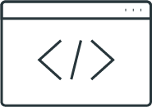
Segue in SQL Injections

Slide 53
Let's look at some queries that may seem pointless or improperly created but are actually fundamental to how SQL injections work.

Slide 54
SQL Injections
What will happen when this query is run?
SELECT * FROM employees WHERE 1=1;

Slide 55
SQL Injections
SELECT * FROM employees WHERE 1=1;
The 1=1 part of the statement will evaluate to true since the number one always equals one, therefore, running the SELECT * FROM employees statement.

Slide 56
Segue in SQL Injections

Slide 58

Using AI to Create a Web Application

Slide 59
We will now use GitHub Copilot, an AI application, to craft our own web application.

Slide 60
Using AI to Create a Web Application
Setting up GitHub Copilot involves a few steps to get everything running.
Prerequisites
GitHub Copilot Extension
Sign In to GitHub
Github Account
Visual Studio Code
Open VS Code
Extension Marketplace
Search for GitHub CoPilot
Install Extension
Activate Extension
Authentication
CoPilot Sign Up
Allow Public Code

Slide 61
Using GitHub Copilot

Slide 62
Creating a Website with Copilot
In this activity, students will continue to play the role of a junior web engineer for the GoodCorp company and will create a basic website.
GoodCorp wants a basic front end that will have an HTML page, CSS styling, and a javascript file.
25 Minutes

Slide 65
Recap
Today’s Lesson Covered:
01
Microservices
02
Stacks
03
Database management with websites
04
Developing a front-end website using Github CoPilot

Slide 66
Introduction to Web Vulnerabilities and Hardening

